Slide 1
SQL JOINS
LEFT JOIN VS RIGHT JOIN

Slide 2
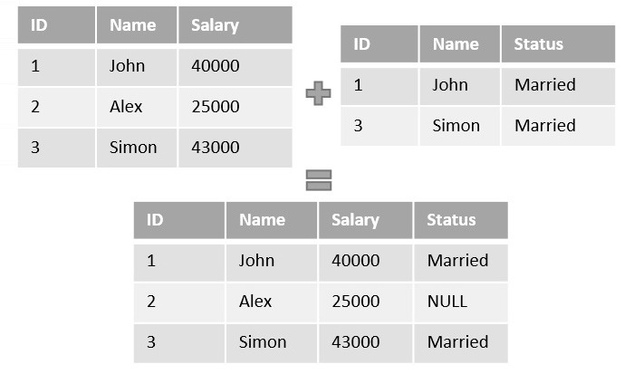

JOINS
It is a clause is used to combine rows from two or more tables, based on a related column between them.
Table 1 - Salary Information
Table 2 - Marital Status
Information

Slide 3
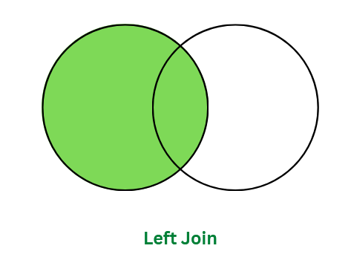
LEFT JOIN
This join returns all the rows of the table on the left side of the join and matches rows for the table on the right side of the join.
SYNTAX
SELECT table1.column1,table1.column2,...
FROM table1
LEFT JOIN table2
ON
table1.matching_column = table2.matching_column;
TABLE A
TABLE B

Slide 4
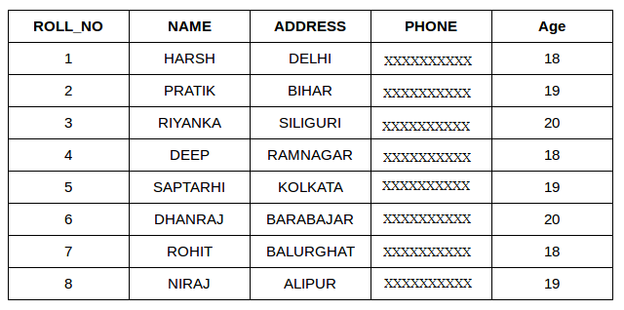
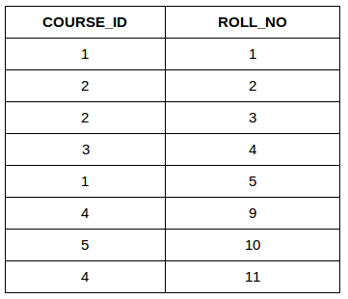
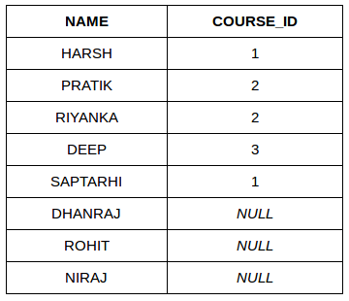
Student
Student Course
LEFT JOIN
COMMON COLUMN - ROLL_NO
Name and Course ID of students enrolled in different courses.
=

Slide 5
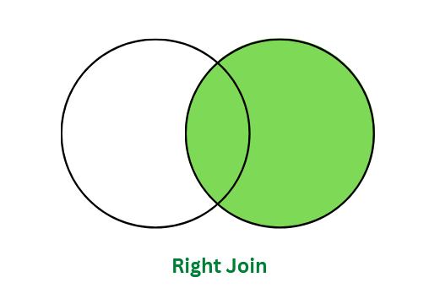
RIGHT JOIN
This join returns all the rows of the table on the right side of the join and matching rows for the table on the left side of the join.
SYNTAX
SELECT table1.column1,table1.column2,....
FROM table1
RIGHT JOIN table2
ON
table1.matching_column = table2.matching_column;
TABLE A
TABLE B

Slide 6
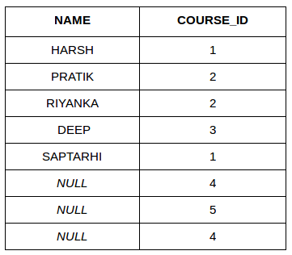
Student
Student Course
RIGHT JOIN
COMMON COLUMN - ROLL_NO
Name and Course ID of students enrolled in different courses.
=

Slide 7
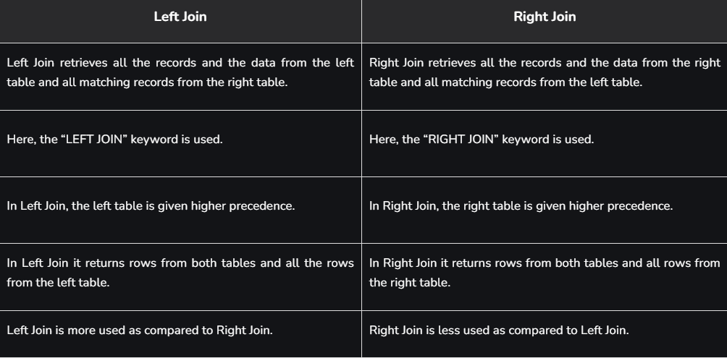
LEFT JOIN VS RIGHT JOIN

Slide 8
THANK YOU !!

